Slide 1
Introduction to R with Power BI
Notes:
This module provides a fast and furious introduction to R as the world’s most popular platform for advanced data analytics and data visualization. Students will learn how to get up and running with the R platform by installing the Microsoft R Client and a trial version of RStudio. The module introduces students to R language syntax fundamentals and explains how import and consume R packages in a custom solution. Students will begin their lives as an R coder by writing and executing simple scripts using RStudio. After that, the module demonstrates how to take advantage of the R integration with Power BI Desktop which makes it possible to create and execute R scripts and to generate enhanced charts and graphs using powerful library packages that have been made so popular by the world-wide R community.

Slide 2
Agenda
Understanding R as an Analytics Platform
Installing Microsoft R Open and RStudio
Writing R Code in RStudio
Integrating R with Power BI Desktop

Slide 3
What is R?
What is R?
Platform for statistics, data analysis and visualization
Free, cross-platform, open source software
Programming language + Runtime layer + Libraries
R code distributed and versioned using packages
Flourishing ecosystem of R package authors
Why do you need it?
Analyzing data and generating statistics
Creating rich graphs and charts
Fitting statistical models for predictive analysis

Slide 4
R Packages
Package is versioned redistributable unit of code
Package contains functions, data and compiled code
R is installed with a default set of packages
Other packages can be downloaded and installed
Examples of available domain-specific packages
Packages to download and unpack data in zip archive
Packages to create fancy charts and graphs
Packages to optimize financial portfolios
Packages predict component failure times
Packages to analyze genomic sequences

Slide 5
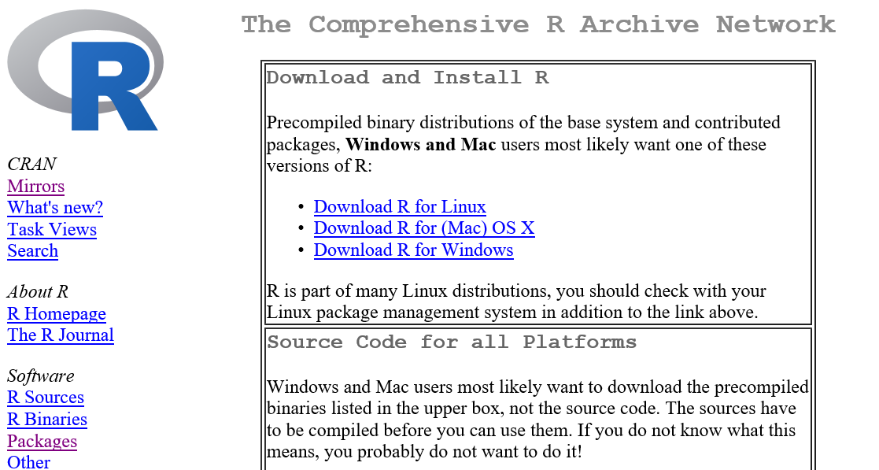
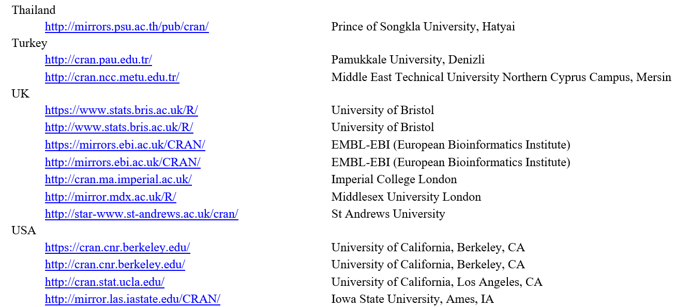
CRAN
The Comprehensive R Archive Network
Public archive with over 8,000 downloadable packages
http://cran.us.r-project.org/

Slide 6
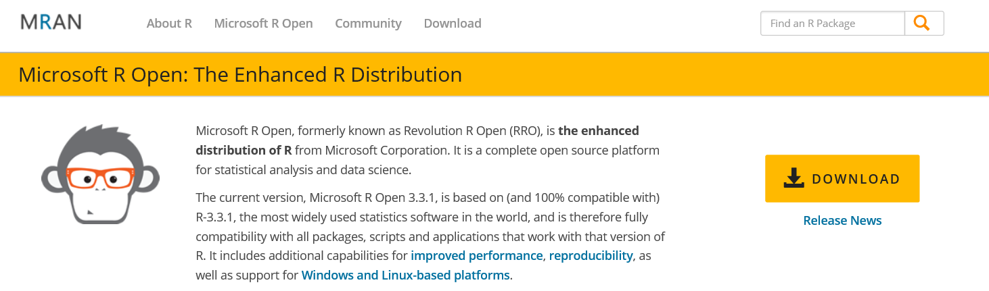
Microsoft R Open
What is Microsoft R Open?
An enhanced distribution of R from Microsoft
Improved performance and multithreading
Reproducibility through package versioning stability
Free, cross-platform, open source software
Available at https://mran.microsoft.com/open/

Slide 7
Stages of R Awareness
Stage 1: Standing Up
Installing the environment and playing with data
Stage 2: Walking
Writing & testing R code and creating graphs and charts
Stage 3: Jogging
Crunching numbers to generate advanced statistics
Stage 4: Running
Creating a domain-specific predictive model
Stage 5: Sprinting
Distributing your predictive model as a CRAN package

Slide 8
Agenda
Understanding R as an Analytics Platform
Installing Microsoft R Open and RStudio
Writing R Code in RStudio
Integrating R with Power BI Desktop

Slide 9
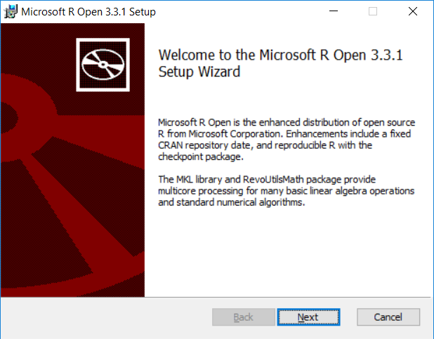
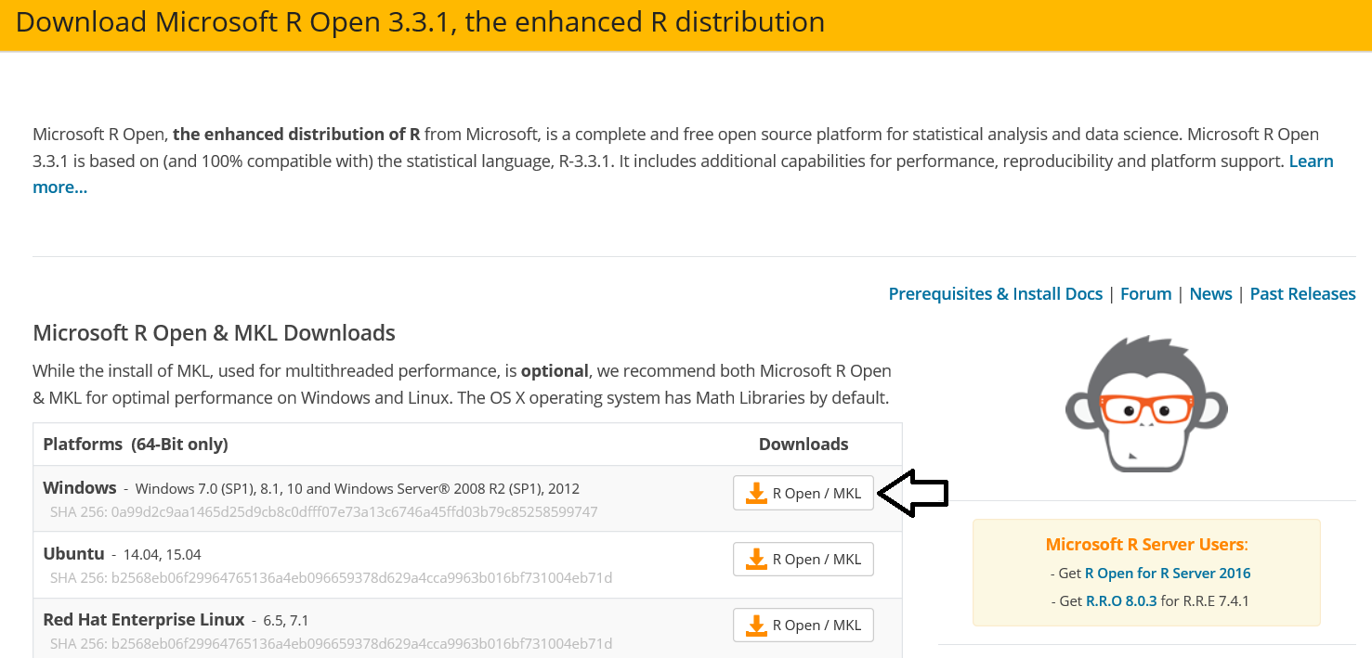
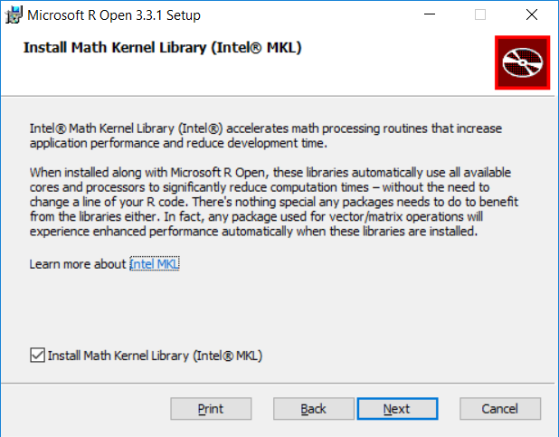
Install Microsoft R Open
https://mran.microsoft.com/download/

Slide 10
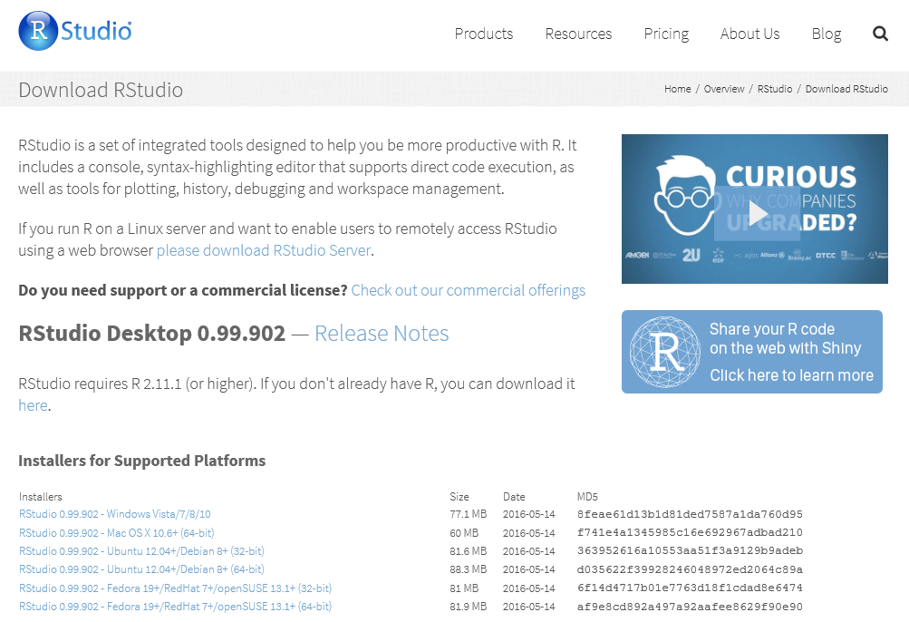
Installing R Studio
https://www.rstudio.com/products/rstudio/download/

Slide 11
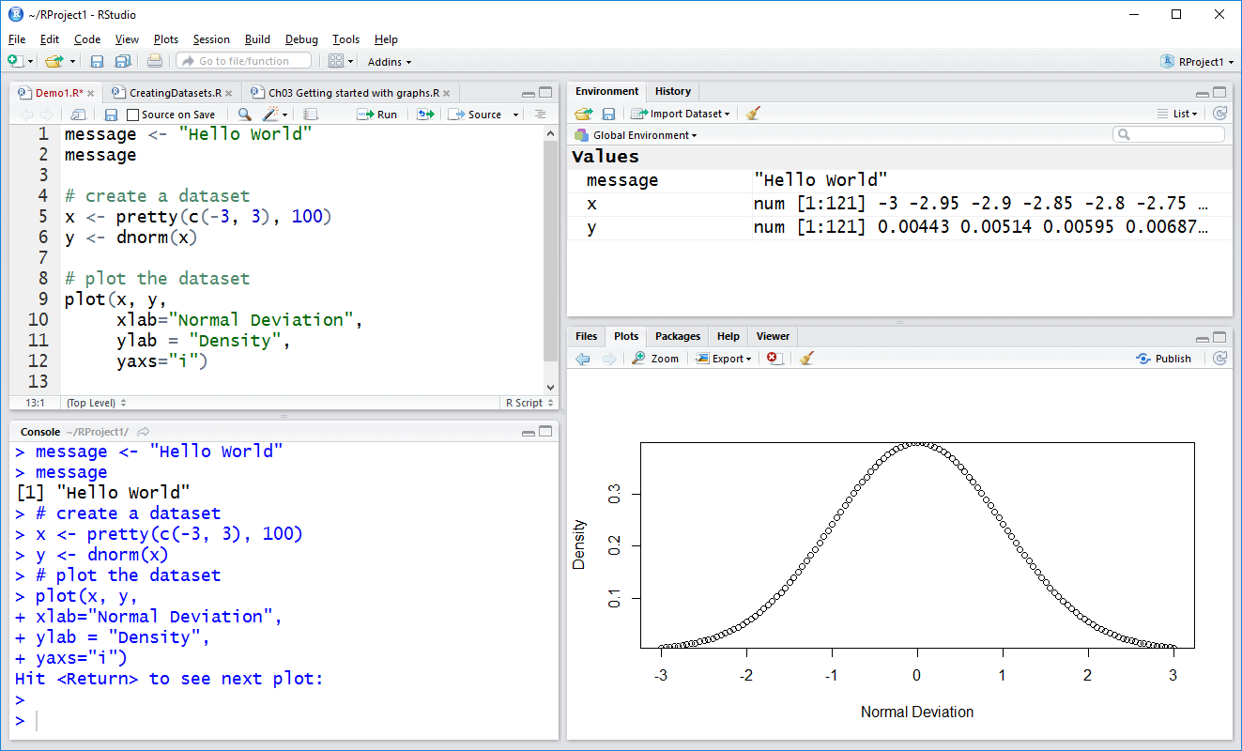
The RStudio IDE

Slide 12
Agenda
Understanding R as an Analytics Platform
Installing Microsoft R Open and RStudio
Writing R Code in RStudio
Integrating R with Power BI Desktop

Slide 13
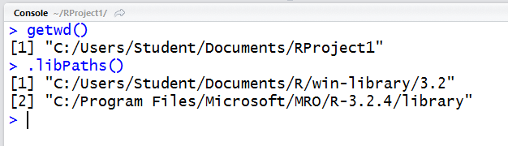
R Projects and Workspaces
R projects based on folder structure
Data and scripts added to current working directory
Each R project defines a workspace
Workspace tracks set of user-defined objects
Workspace defines set of loaded packages
Workspace data saved/loaded using .RData files

Slide 14
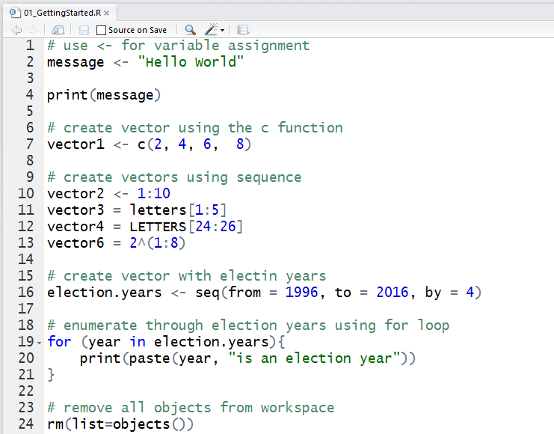
Writing and Testing R Code in Scripts

Slide 15
R Objects
In R, variables represent named objects
Object names can contain
Letters
Numbers
Underscores (_)
Dots (.)

Slide 16
Essential Data Structures in R
Vector
One-dimensional, single-mode array
Matrix
Two-dimensional, single-mode array
Array
N-dimensional, single-mode array
List
Ordered collection of multi-mode objects
Data frame
Two-dimensional, multi-mode array
Factor
Integer-backed list of categorical values

Slide 17
Writing and Testing R Code in RStudio

Slide 18
Creating Graphs using RStudio

Slide 19
Agenda
Understanding R as an Analytics Platform
Installing Microsoft R Open and RStudio
Writing R Code in RStudio
Integrating R with Power BI Desktop

Slide 20
Where Can You Use R Code in PBIDT?
As a data source to a query
You can use R code to import and reshape data
Within a Query Applied Step
You can use R code to add transforms to a query
Inside an R Visual in a Power BI Report
You can use R code to creates charts from your data

Slide 21
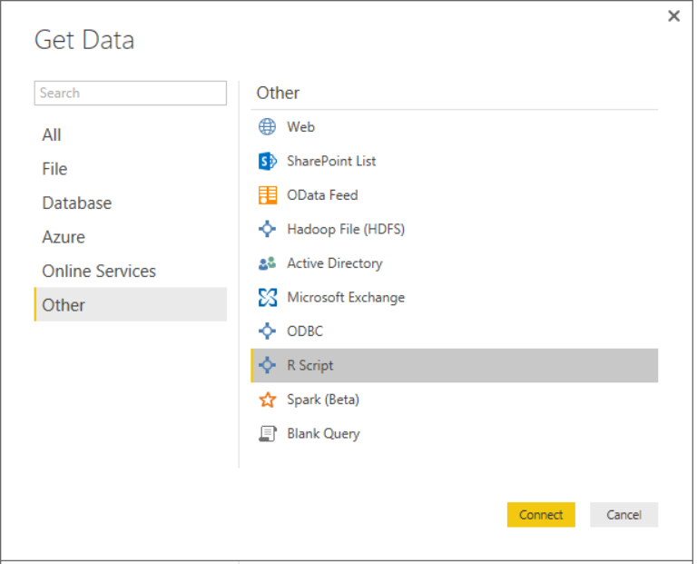
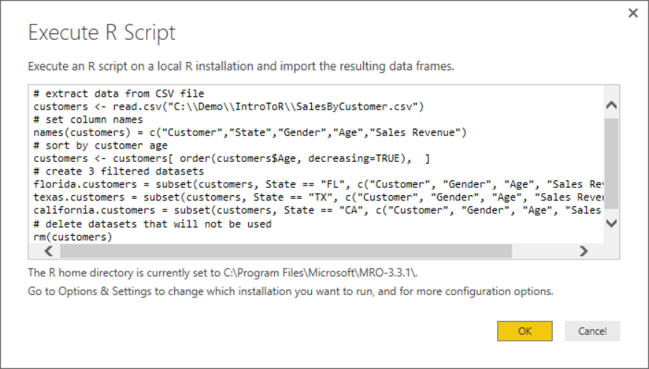
Using R Code as a Query Data Source
Create new query based on R script
Copy and paste code from RStudio into PBIDT

Slide 22
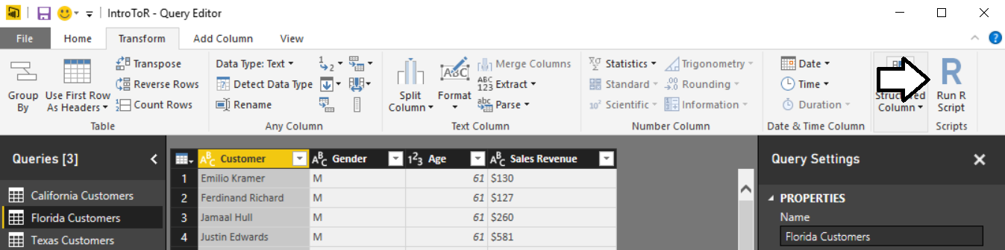
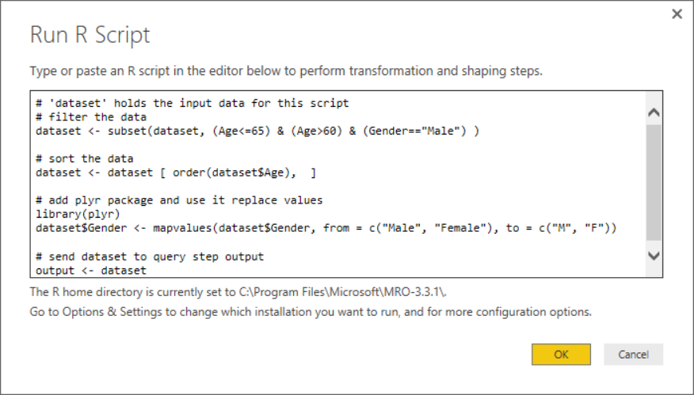
Using R Code as an Applied Query Step
Add new Run R Script step to query
Use R code and R packages to transform data

Slide 23
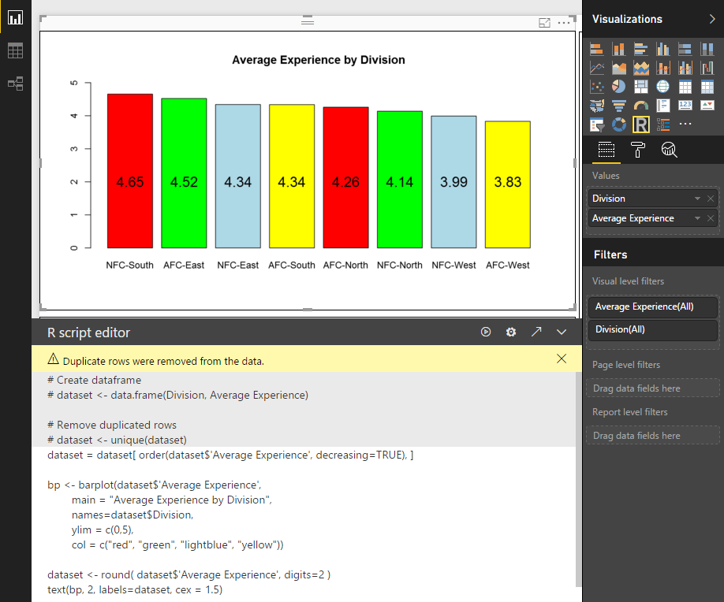
R Visuals in Power BI

Slide 24
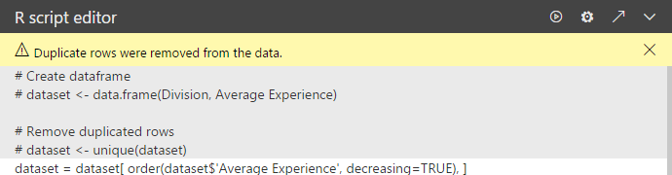
New R Features in September Release
Edit R code in external editor
Run the script
Go to Data Load settings
Expand/collapse R coding pane

Slide 25
R Integration Limitations with Power BI
Power BI Desktop R Limitations
Only data frames are imported
Complex columns and Vector columns are not imported
Values that are N/A are translated to NULL values
Prompting for user input halts script
R visual data for plotting is limited to 150,000 rows
R visual calculation times out with error after 5 minutes
R visual is not interactive – no highlighting support
Plots can only be displayed to R default display device

Slide 26
Summary
Understanding R as an Analytics Platform
Installing Microsoft R Open and RStudio
Writing R Code in RStudio
Integrating R with Power BI Desktop

